Slide 1
DECISION CONTROL STRUCTURE

Slide 2
A decision control instruction can be implemented in C using:
The if statement
if-else statement
The conditional operators

Slide 3
The Decision Control Structure
The general form of if statement looks
like this:
if ( this condition is true )
execute this statement ;

Slide 4
The keyword if tells the compiler that what follows is a decision control instruction.
The condition following the keyword if is
always enclosed within a pair of parentheses.
If the condition, whatever it is, is true, then the statement is executed.
If the condition is not true then the statement is not executed;

Slide 5
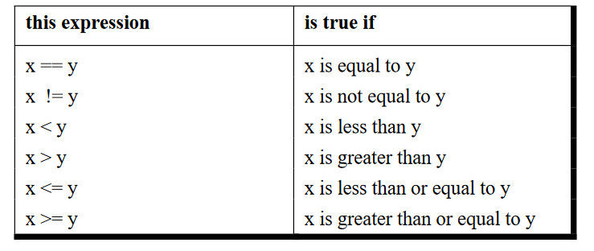

Slide 6
/* Demonstration of if statement */
main( )
{
int num ;
printf ( "Enter a number less than 10 " ) ;
scanf ( "%d", &num ) ;
if ( num <= 10 )
printf ( "What an obedient servant you are !" ) ;
}

Slide 7
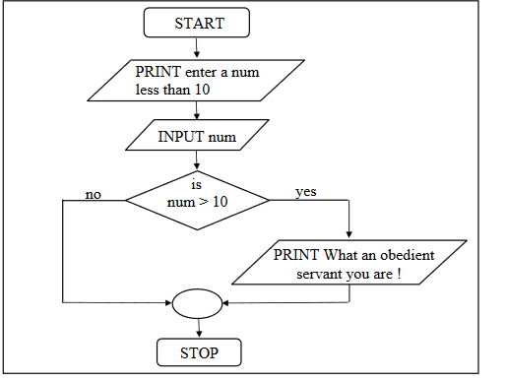

Slide 8
The if-else Statement
The if statement by itself will execute a single statement, or a group of statements, when the expression following if evaluates to true.
It does nothing when the expression evaluates to false.

Slide 9
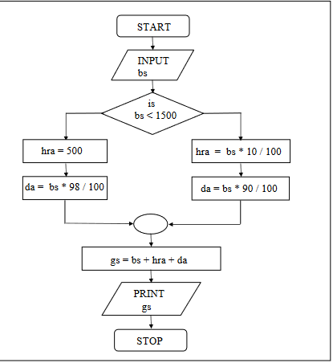

Slide 10
/* Calculation of gross salary */
main( )
{
float bs, gs, da, hra ;
printf ( "Enter basic salary " ) ;
scanf ( "%f", &bs ) ;
if ( bs < 1500 )
{
hra = bs * 10 / 100 ;
da = bs * 90 / 100 ;
}
else
{
hra = 500 ;
da = bs * 98 / 100 ;
}
gs = bs + hra + da ;
printf ( "gross salary = Rs. %f", gs ) ;
}

Slide 11
Nested if-elses
It is perfectly all right if we write an entire if-else construct within either the body of the if statement or the body of an else statement.
This is called ‘nesting’of ifs. This is shown in the following program.

Slide 12
/* A quick demo of nested if-else */
main( )
{
int i ;
printf ( "Enter either 1 or 2 " ) ;
scanf ( "%d", &i ) ;
if ( i == 1 )
printf ( "You would go to heaven !" ) ;
else
{
if ( i == 2 )
printf ( "Hell was created with you in mind" ) ;
else
printf ( "How about mother earth !" ) ;
}
}

Slide 13
Forms of if
The if statement can take any of the following forms:
(a)
if ( condition )
do this ;
(b)
if ( condition )
{
do this ;
and this ;
}
(c)
if ( condition )
do this ;
else
do this ;
(d)
if ( condition )
{
do this ;
and this ;
}
else
{
do this ;
and this ;
}

Slide 14
(e) if ( condition )
do this ;
else
{
if ( condition )
do this ;
else
{
do this ;
and this ;
}
}
(f) if ( condition )
{
if ( condition )
do this ;
else
{
do this ;
and this ;
}
}
else
do this ;

Slide 15
Use of Logical Operators
C allows usage of three logical operators, namely, &&, || and !.
These are to be read as ‘AND’ ‘OR’ and ‘NOT’ respectively.
There are several things to note about these logical operators.
Most obviously, two of them are composed of double symbols: || and &&.

Slide 16
* Method – I */
main( )
{
int m1, m2, m3, m4, m5, per ;
printf ( "Enter marks in five subjects " ) ;
scanf ( "%d %d %d %d %d", &m1, &m2, &m3, &m4, &m5 ) ;
per = ( m1 + m2 + m3 + m4 + m5 ) / 5 ;
Chapter 2: The Decision Control Structure 65
if ( per >= 60 )
printf ( "First division ") ;
else
{
if ( per >= 50 )
printf ( "Second division" ) ;
else
{
if ( per >= 40 )
printf ( "Third division" ) ;
else
printf ( "Fail" ) ;
}
}
}

Slide 17
* Method – II */
main( )
{
int m1, m2, m3, m4, m5, per ;
printf ( "Enter marks in five subjects " ) ;
scanf ( "%d %d %d %d %d", &m1, &m2, &m3, &m4, &m5 ) ;
per = ( m1 + m2 + m3 + m4 + m5 ) / 5 ;
66 Let Us C
if ( per >= 60 )
printf ( "First division" ) ;
if ( ( per >= 50 ) && ( per < 60 ) )
printf ( "Second division" ) ;
if ( ( per >= 40 ) && ( per < 50 ) )
printf ( "Third division" ) ;
if ( per < 40 )
printf ( "Fail" ) ;
}

Slide 18
The else if Clause
There is one more way in which we can write program for
Example 2.4. This involves usage of else if blocks as shown
below:
Chapter 2: The Decision Control Structure 67
/* else if ladder demo */
main( )
{
int m1, m2, m3, m4, m5, per ;
per = ( m1+ m2 + m3 + m4+ m5 ) / per ;
if ( per >= 60 )
printf ( "First division" ) ;
else if ( per >= 50 )
printf ( "Second division" ) ;
else if ( per >= 40 )
printf ( "Third division" ) ;
else
printf ( "fail" ) ;
}

Slide 19
The ! Operator
we have used only the logical operators && and ||.
The third logical operator is the NOT operator, written as !.
! ( y < 10 )
This means “not y less than 10”. In other words, if y is less than
10, the expression will be false, since ( y < 10 ) is true. We can
express the same condition as ( y >= 10 ).

Slide 20
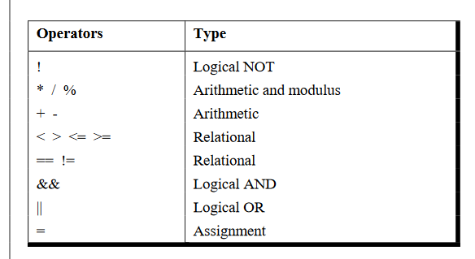
Hierarchy of Operators Revisited

Slide 21
The Conditional Operators
The conditional operators ? and : are sometimes called ternary operators since they take three arguments.
Their general form is,
expression 1 ? expression 2 : expression 3
What this expression says is: “if expression 1 is true (that is, if its
value is non-zero), then the value returned will be expression 2,
otherwise the value returned will be expression 3”

Slide 22
What this expression says is:
“if expression 1 is true (that is, if its
value is non-zero), then the value returned will be expression 2,
otherwise the value returned will be expression 3”.
Let us understand this with the help of a few examples:
(a) int x, y ;
scanf ( "%d", &x ) ;
y = ( x > 5 ? 3 : 4 ) ;
This statement will store 3 in y if x is greater than 5,
otherwise it will store 4 in y.
The equivalent if statement will be,
if ( x > 5 )
y = 3 ;
else
y = 4 ;

